Slide 1
Programming 4
11.2 Intro to Python
Semester 2, 2019

Slide 2
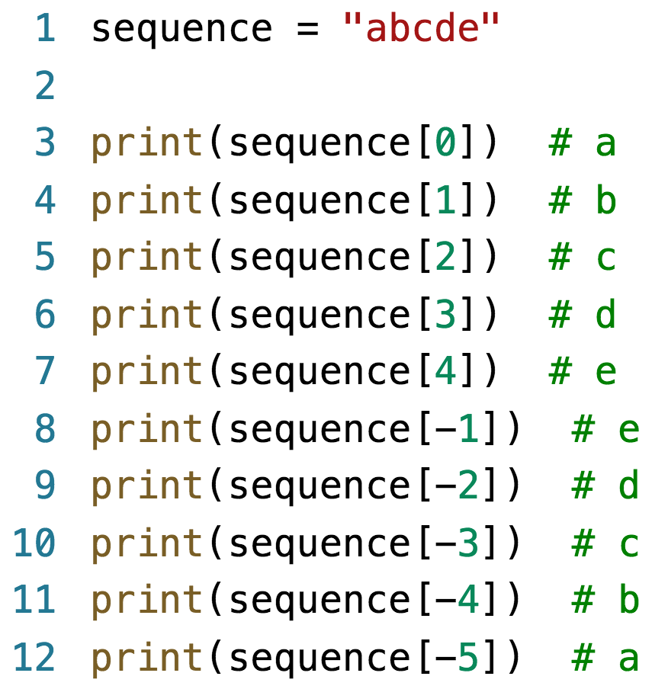
Sequences
Ordered sets.
Powerful operation on sequence types.

Slide 3
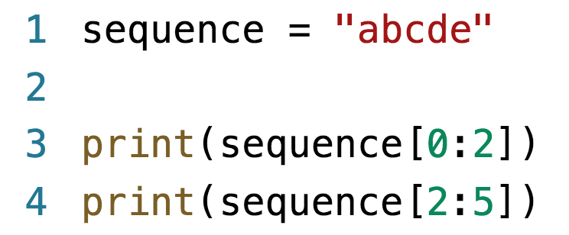
Index slicing
More complex indexing option.
Start is inclusive and end is exclusive.
Negative index slicing.
Good for stripping strings.
Check for empty strings.

Slide 4
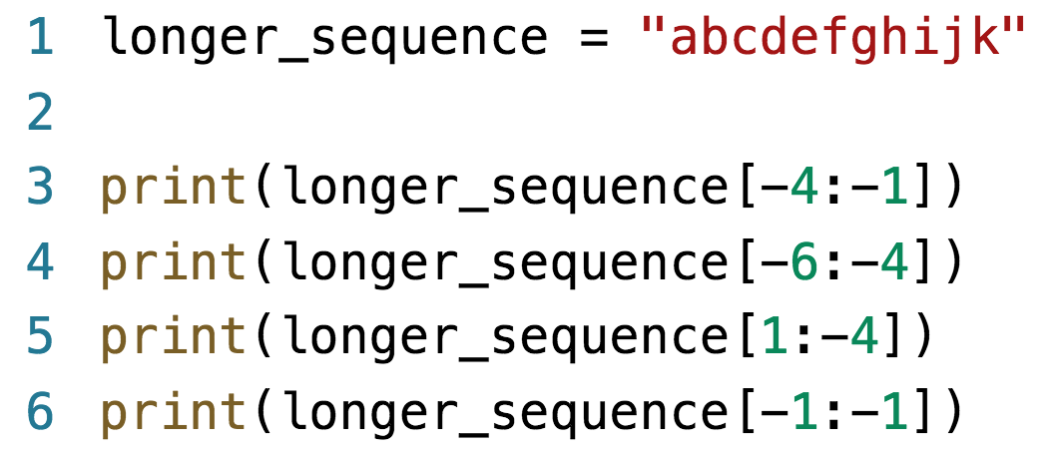
Example – negative index slicing

Slide 5
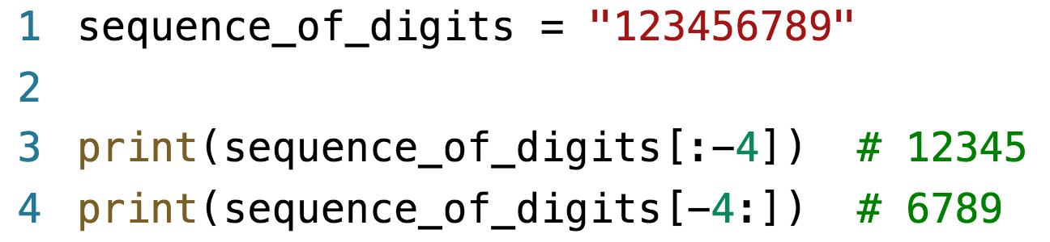
Omitting an index
Means “all”.
[start:] – from start (inclusive) to end.
[:end] – from start to end (exclusive).

Slide 6
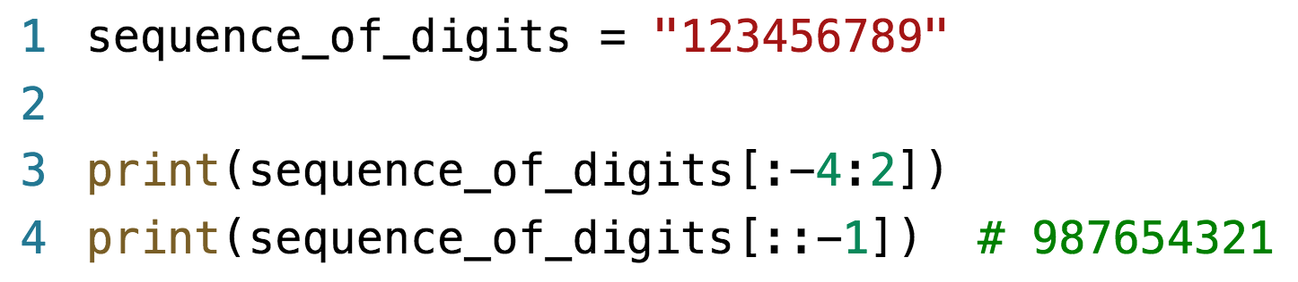
Step
Optional 3rd argument.
[start:end:step]
Start and end must describe a right to left slice.
Excellent way to reverse a string.

Slide 7
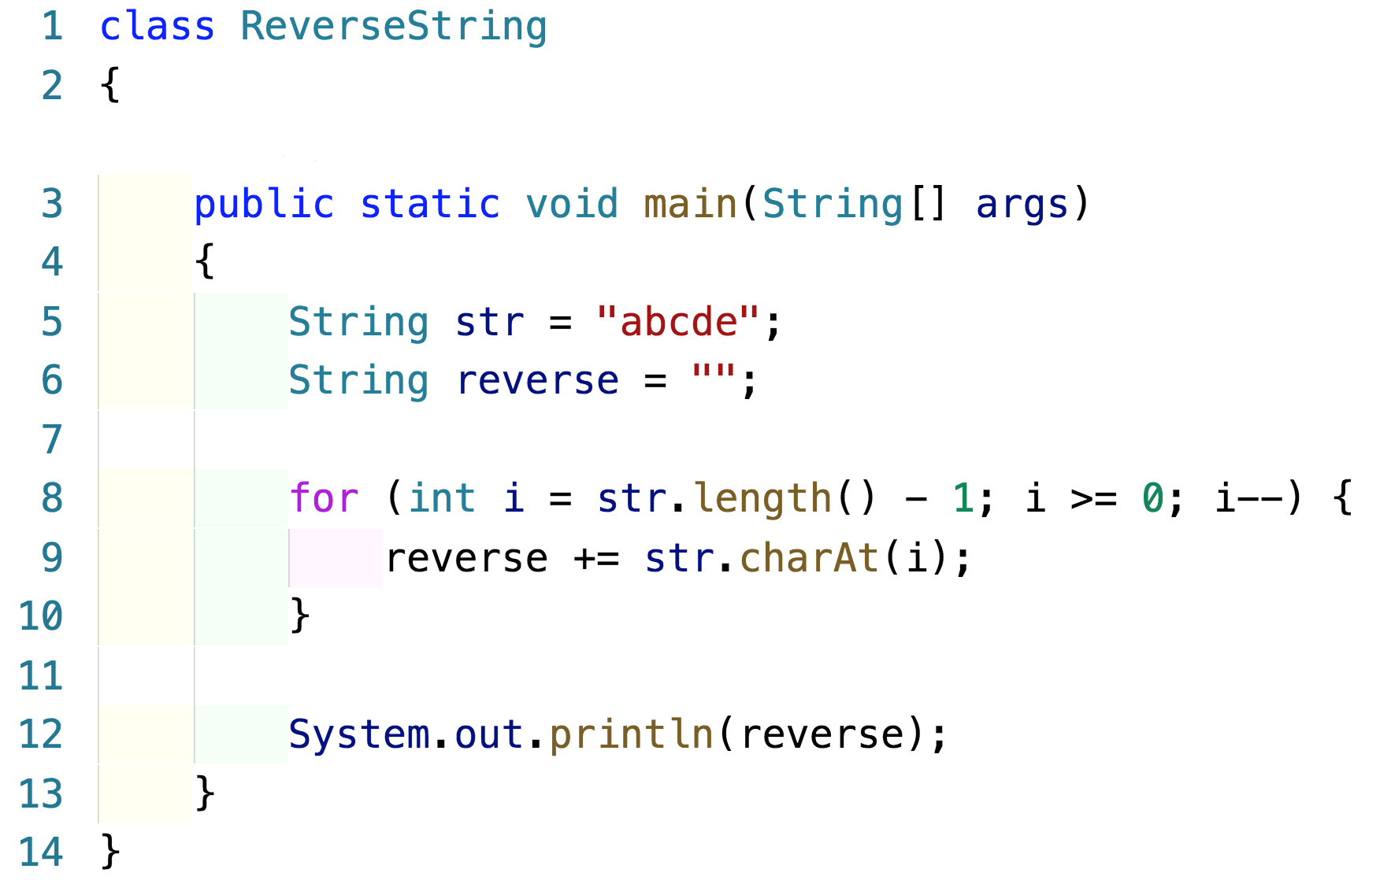
Example – reversing a string in Java

Slide 8
Sequence types
Lists = []
Tuples = ()
Dictionaries = {}
Lists and dictionaries are mutable.
Tuples are immutable.
Dictionaries are key : value pairs.

Slide 9
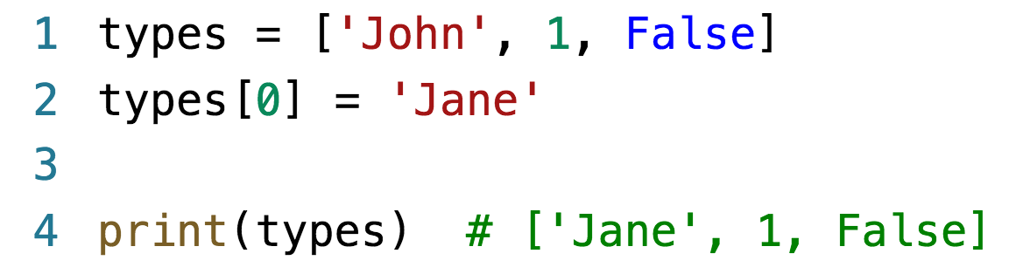
Lists
Like strings, you can slice on lists.

Slide 10
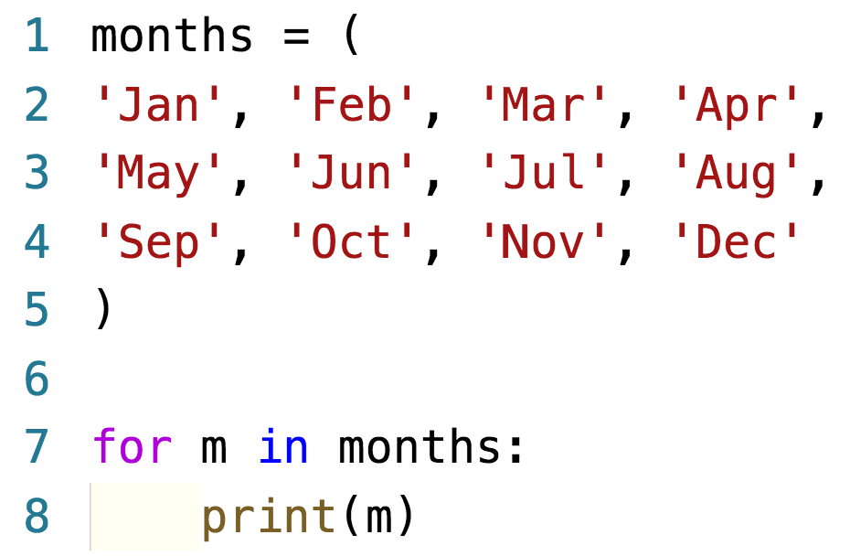
Tuples
Once declared, they can’t be changed.
Used liked a database record.
TypeError: ‘tuple’ object does not support item assignment.

Slide 11
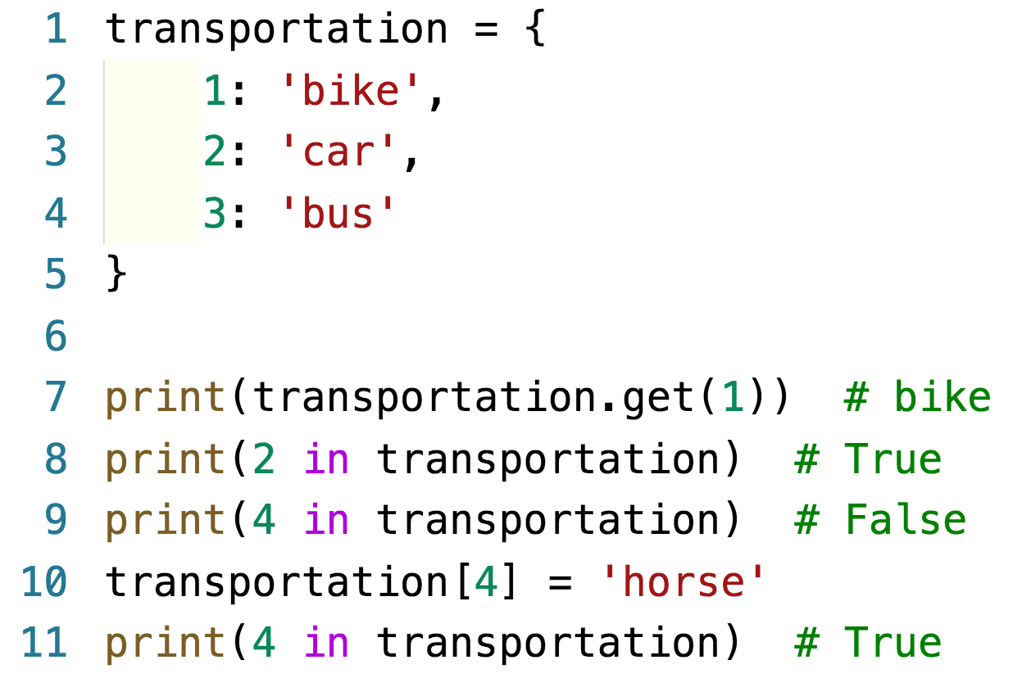
Dictionaries
All languages should have a type of dictionary.
They are seperated by a colon.

Slide 12
Classes
Declare with class keyword.
Methods are declared within the code block.
All methods have self as their 1st argument.
The constructor must be called __init__
Data members:
Are not pre-declared.
If created outside any method, they are static.
If created inside a method without prefix, they are local to the method.
If declared inside a method and prefaced with self, they are class data members.

Slide 13
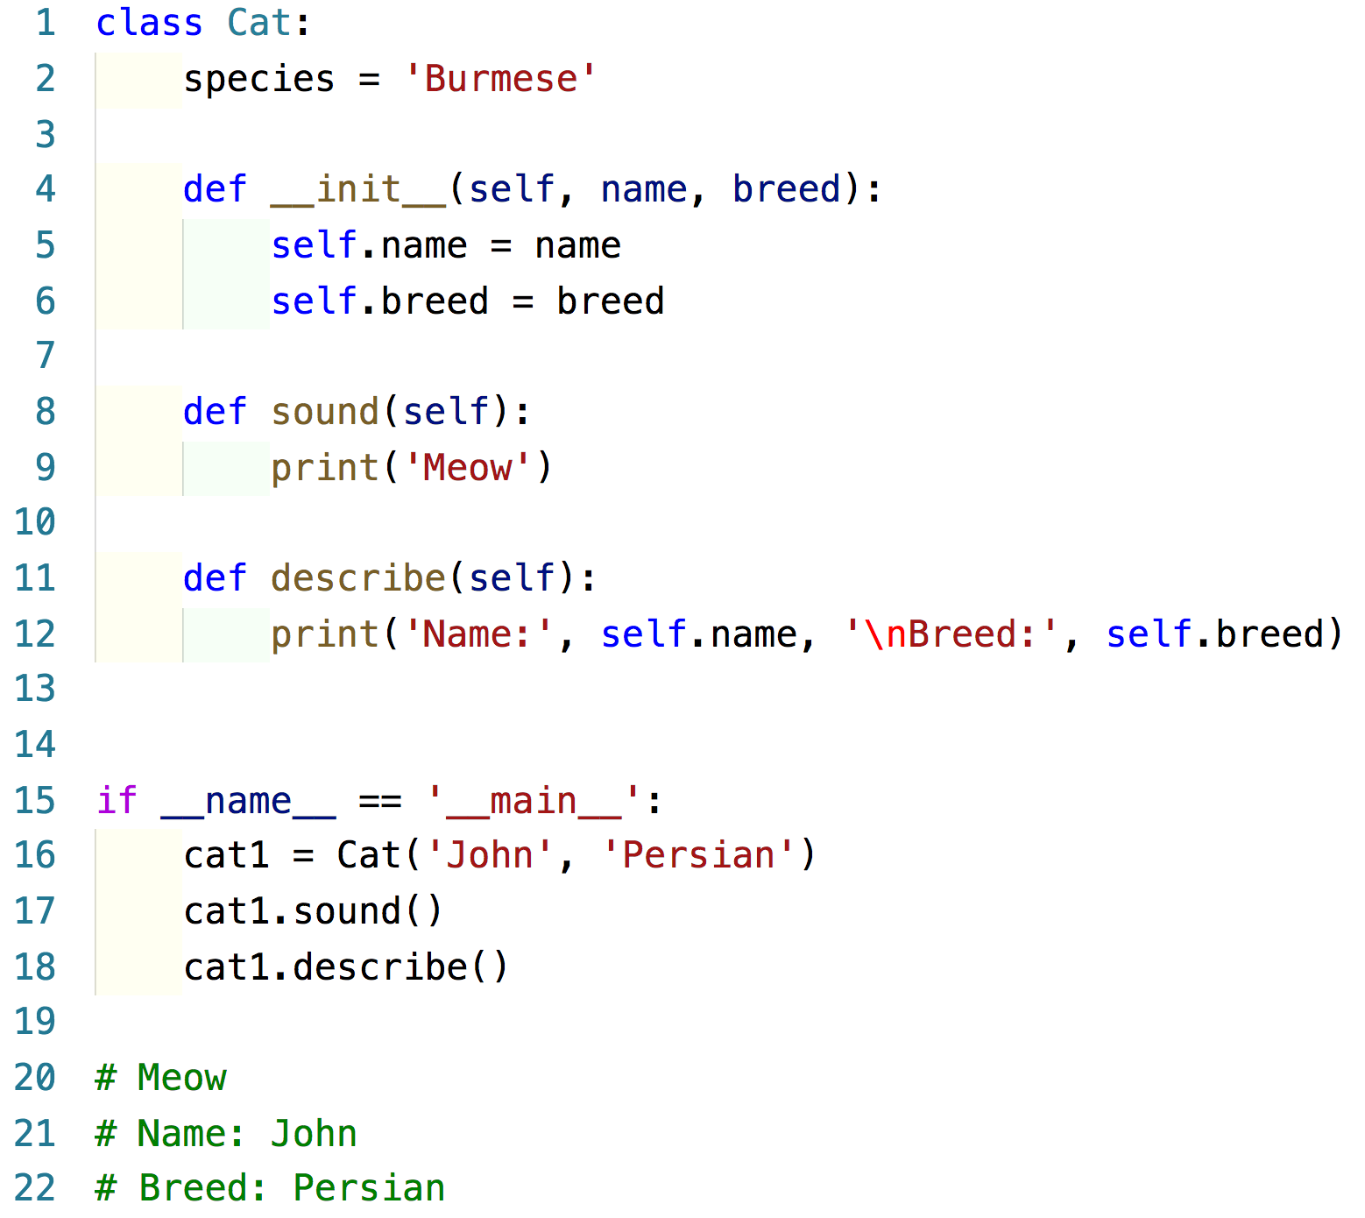
Example – classes

